Slide 1

6th Grade Math
Unit 7, Lesson 4 Adding Integers Using Number Lines Volume 2, pg. 19

Slide 2


Benchmark
MA.6.NSO.4.1
Apply and extend previous understandings of operations with whole numbers to add and subtract integers with procedural fluency.
volume 2, pg. 19

Slide 3
Integrated Mathematical Thinking and Reasoning Standard
MA.K12.MTR.2.1 Demonstrate understanding by representing problems in multiple ways.
volume 2, pg. 19

Slide 4

Learning Target
I can add integers using a number line.
volume 2, pg. 19

Slide 5

Warm-Up
volume 2, pg. 19

Slide 6
7.4.1 Warm-Up: Speed Is Not Important
How fast you perform calculations in mathematics is not at all related to how “good” you are at math. Fast calculation is not important. What matters is deep thinking and understanding.
Describe a time when you felt rushed to perform calculations on a math assignment or assessment.
volume 2, pg. 19

Slide 7
If you were given as much time as you needed in the situation you described, how would that have affected your feelings and performance on completing the assignment or assessment?
volume 2, pg. 19

Slide 8

Refresher
volume 2, pg. 20

Slide 9

7.4.2 Refresher: Plotting Numbers on a Number Line
Plot each of the following integers on the number line below. Label each point with the letter indicated.
$$A = 4$$ | $$B = −4$$ | $$C = −16$$ | $$D = 8$$ | $$E = 18$$ | $$F = −19$$
volume 2, pg. 20

Slide 10
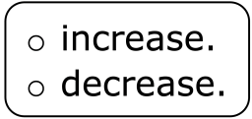
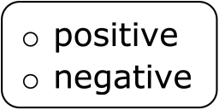
Complete the statements.
When moving from left to right (→) on the number line, the
values This can be described as moving in a
direction.
When moving from right to left (←) on the number line, the
values This can be described as moving in a
direction.
volume 2, pg. 20

Slide 11

Guided Instruction
volume 2, pg. 20

Slide 12

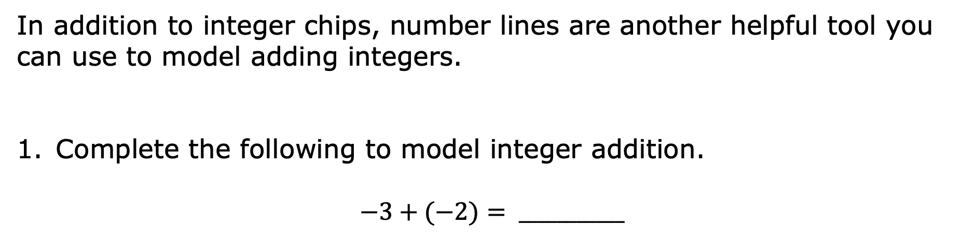
7.4.3 Guided Instruction: Rules for Adding Integers on a Number Line
In addition to integer chips, number lines are another helpful tool you can use to model adding integers.
Complete the following to model integer addition.
$$−3+(−2)= ___________$$
Integer Chip Model | Number Line Model
volume 2, pg. 20

Slide 13
$$4+\left(−7\right)= ___________$$
Integer Chip Model | Number Line Model
volume 2, pg. 20

Slide 14
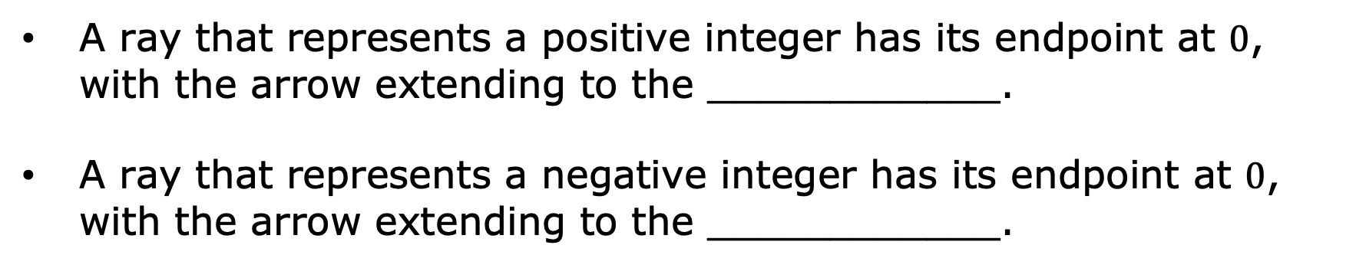
The sum of integers can be represented using rays on a number line. A ray has a single endpoint and extends in a specified direction based on the sign of the integer.
A ray that represents a positive integer has its endpoint at $0$, with the arrow extending to the ____________.
A ray that represents a negative integer has its endpoint at $0$, with the arrow extending to the ____________.
volume 2, pg. 21

Slide 15
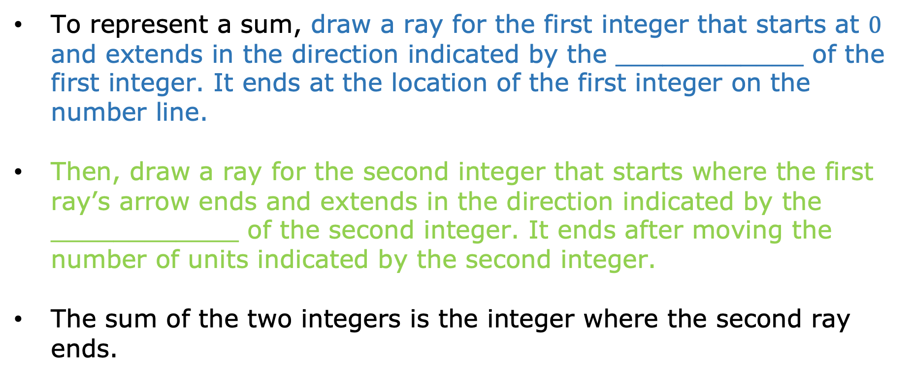
To represent a sum, draw a ray for the first integer that starts at $0$ and extends in the direction indicated by the ____________ of the first integer. It ends at the location of the first integer on the number line.
Then, draw a ray for the second integer that starts where the first ray’s arrow ends and extends in the direction indicated by the ____________ of the second integer. It ends after moving the number of units indicated by the second integer.
The sum of the two integers is the integer where the second ray ends.
volume 2, pg. 21

Slide 16
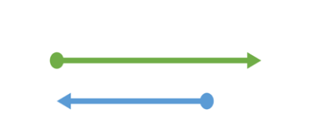
The diagram shown represents $−3 + 4= +1$
Give an example or explain when a number line model would be more useful than using integer chips.
volume 2, pg. 21

Slide 17

Collaboration
volume 2, pg. 21

Slide 18


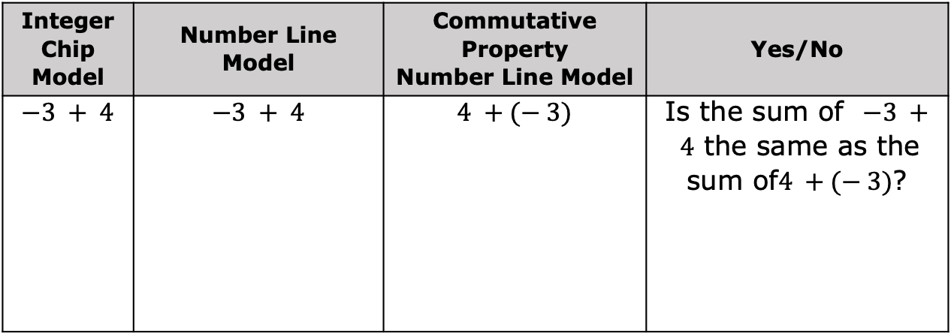
7.4.4 Collaboration: Commutative Property
The commutative property of addition states that the order in which addition is performed does not change the value of the expression.
With your partner, add integers using the commutative property.
Complete the table by sketching the integer chip model for the first column, the number line model for the third column, and answering the question in the last column.
Integer Chip Model | Number Line Model | Commutative Property Number Line Model | Yes/No
$$−3 + 4$$ | $$−3 + 4$$ | $$4 +(− 3)$$ | Is the sum of $−3 + 4$ the same as the sum of$4 +(− 3)$?
volume 2, pg. 21

Slide 19

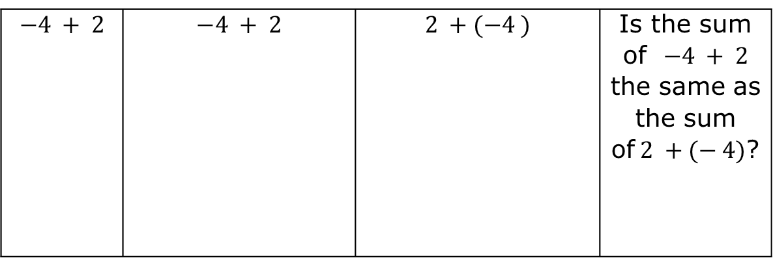
$$−4 + 2$$ | $$−4 + 2$$ | $$2 +(−4 )$$ | Is the sum of $−4 + 2$ the same as the sum of$2 +(− 4)$?
volume 2, pg. 21

Slide 20
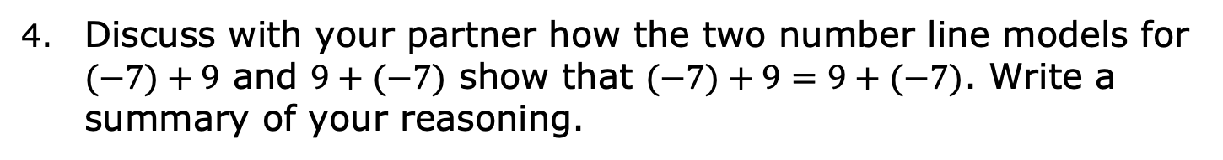
Show the model for $(−7)+9$ on the number line below.
Show the model for $9+(−7)$ on the number line below.
Discuss with your partner how the two number line models for $(−7)+9$ and $9+(−7)$ show that $(−7)+9=9+(−7)$. Write a summary of your reasoning.
volume 2, pg. 22

Slide 21

Try It
volume 2, pg. 22

Slide 22

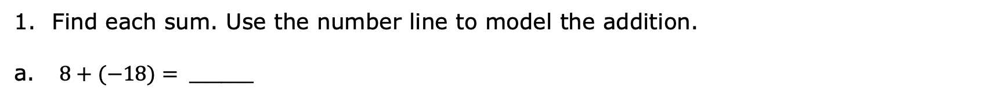
7.4.5 Try It: Adding Integers Using Number Lines
Find each sum. Use the number line to model the addition.
$8+(−18)= ________$
$−7+(−5)= ________$
volume 2, pg. 22

Slide 23

$−3+20= ________$
Write the numerical expression for the model below. Then, find the sum.
volume 2, pg. 22

Slide 24

Your Turn
volume 2, pg. 23

Slide 25

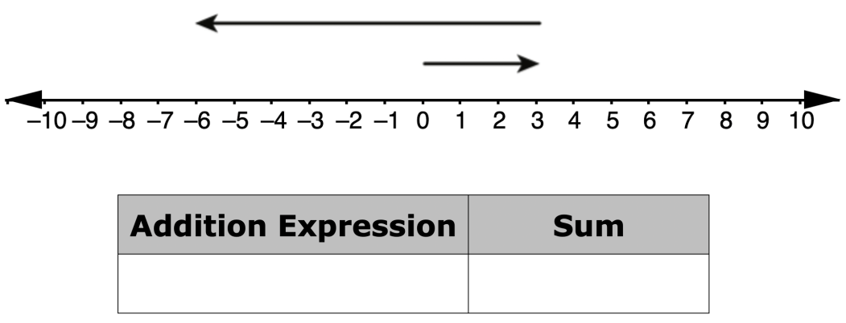
7.4.6 Your Turn!
For each number line model, write the addition expression represented and find the sum.
a.
volume 2, pg. 23

Slide 26
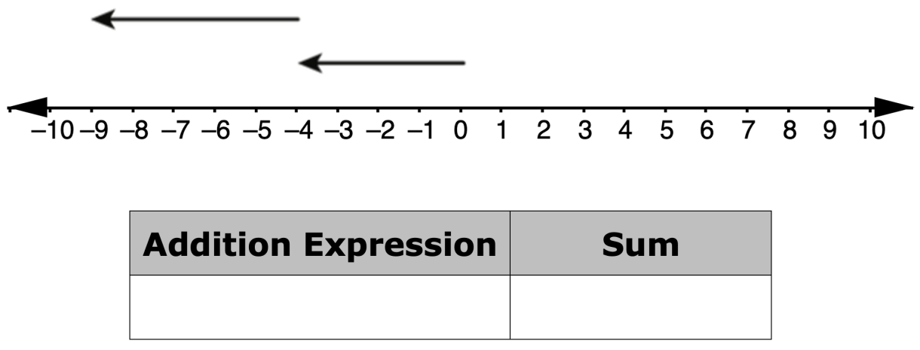
volume 2, pg. 23

Slide 27
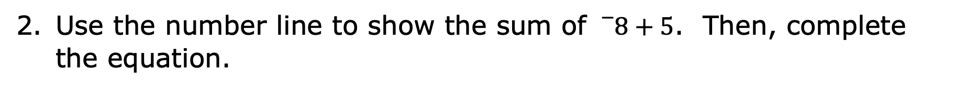
Use the number line to show the sum of ${}_{}^{−}8+5$. Then, complete the equation.
$${}_{}^{−}8+5=_________$$
volume 2, pg. 23

Slide 28
In a single day, the temperature in degrees Fahrenheit (℉) of a town in Canada began at a low of $−20℉$and increased $40℉$ by noon.
Plot a point at the low temperature.
Draw a ray along the number line to represent the increase of 40℉.
Which direction does the arrow extend to show the increase in temperature?
What was the temperature in the town by noon?
volume 2, pg. 23

Slide 29

Wrap-Up
volume 2, pg. 24

Slide 30
7.4.7 Wrap-Up: Reflection
Color in the arrow up to the statement that best describes your current level of confidence with using a number line to add integers.
 | I’m very confident! I can teach anyone how to add integers.
 | I can help others add integers.
 | I can add integers on my own.
 | I can add integers with assistance.
 | I’m having trouble adding integers.
 | I’m not sure what integers are.
volume 2, pg. 24

